Slide 1






ITI Examination System
POWER BI DEVELOPMENT TRACK
ITP - 2025 - Q3
ITI Minya

Slide 2

Our Team
Ahmed
Mahmoud
Nada
Adham
Mohammed
Mostafa

Slide 3


Introduction
The ITI Examination System is an enterprise-level educational technology platform designed to operate within the existing infrastructure of the Information Technology Institute (ITI).
It will replace and enhance current manual or disparate systems for examination management, providing a centralized, automated, and data-driven solution.

Slide 4
Process
1
2
3
Requirements
SRS Document
Notion Plan according to Agile principles
GitHub
DATABASES
ERD / Schema
Mapping Model
Examination_OLTP
Examination_OLAP
ETL TOOLS
SSIS
SSAS
SSRS
4
5
6
Dashboards
Power BI
Facebook API
Excel
Tableau
GEN AI
LLM
RAG
3 Modes
Website
Interface
Dynamic Process
Simple GUI
OLTP in Backend

Slide 5
Requirements

Slide 6
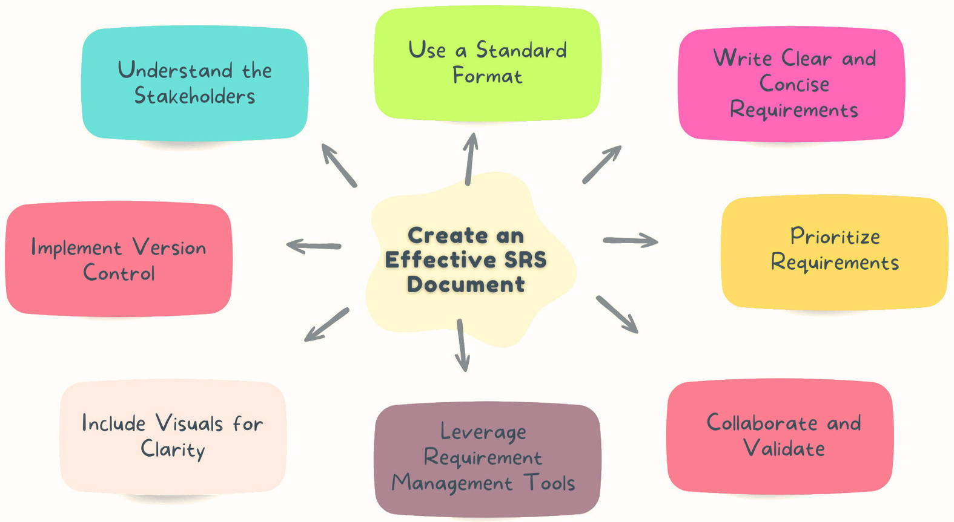
SRS

Slide 7
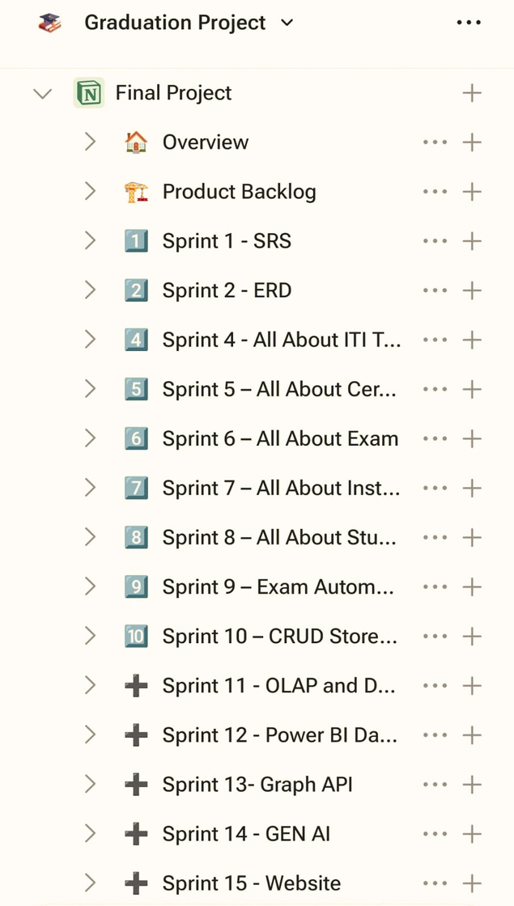
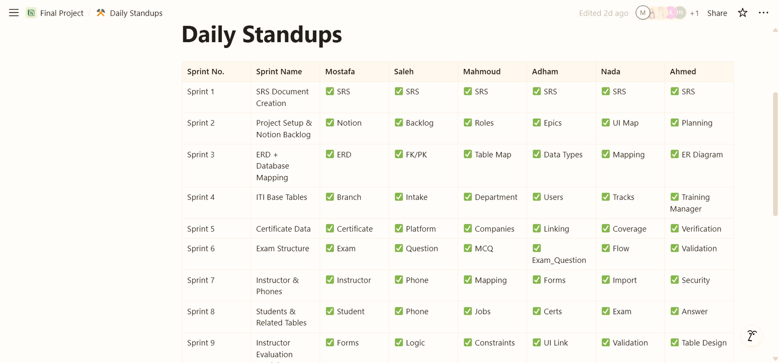
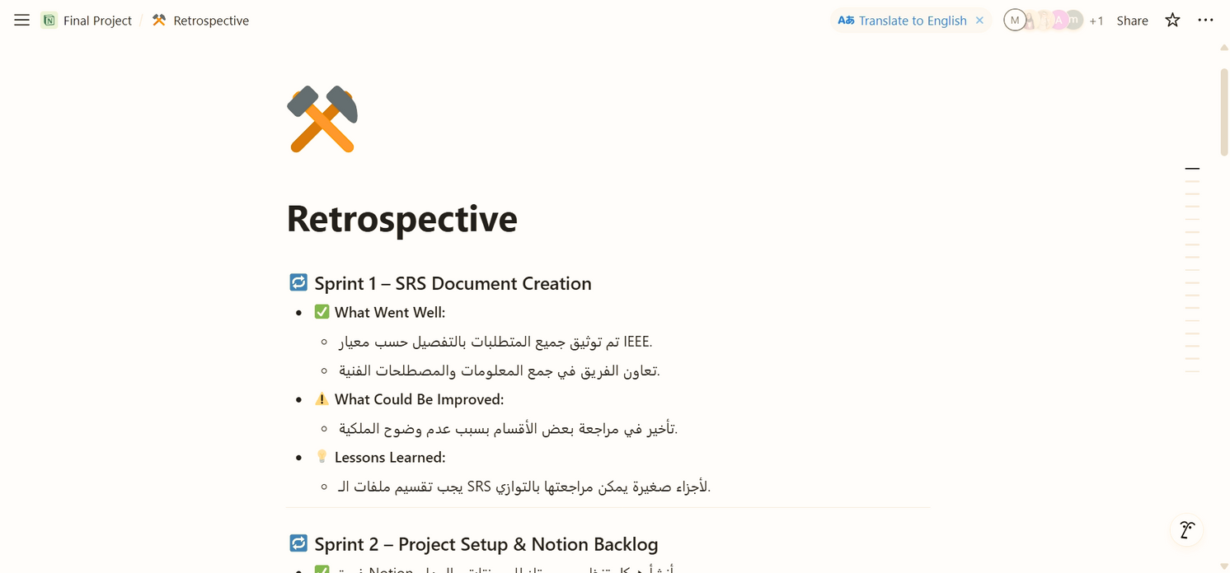
Notion Plan

Slide 8
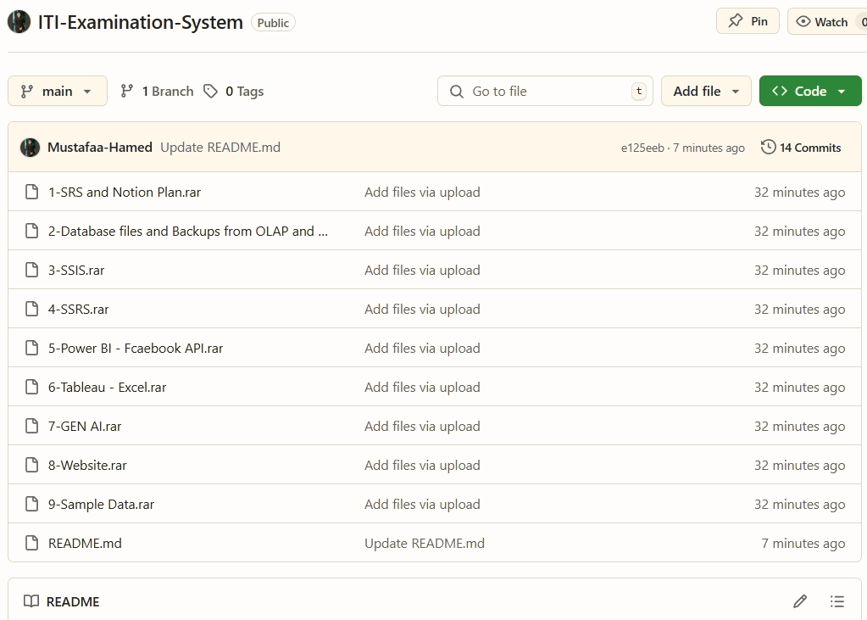
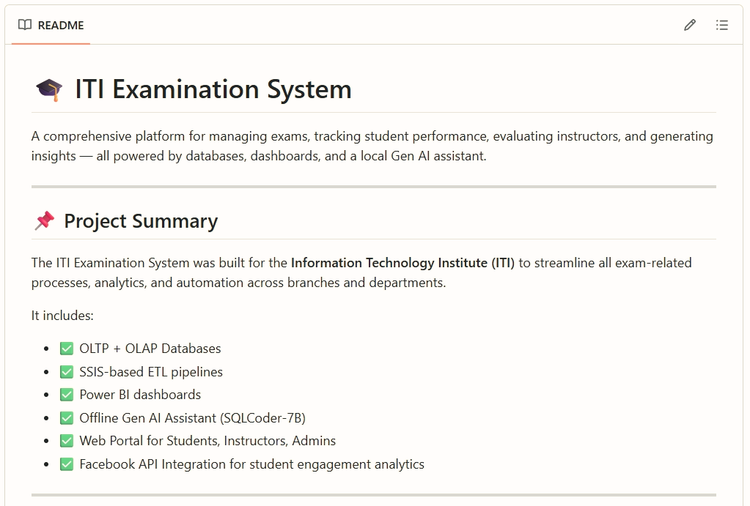
GitHub

Slide 9
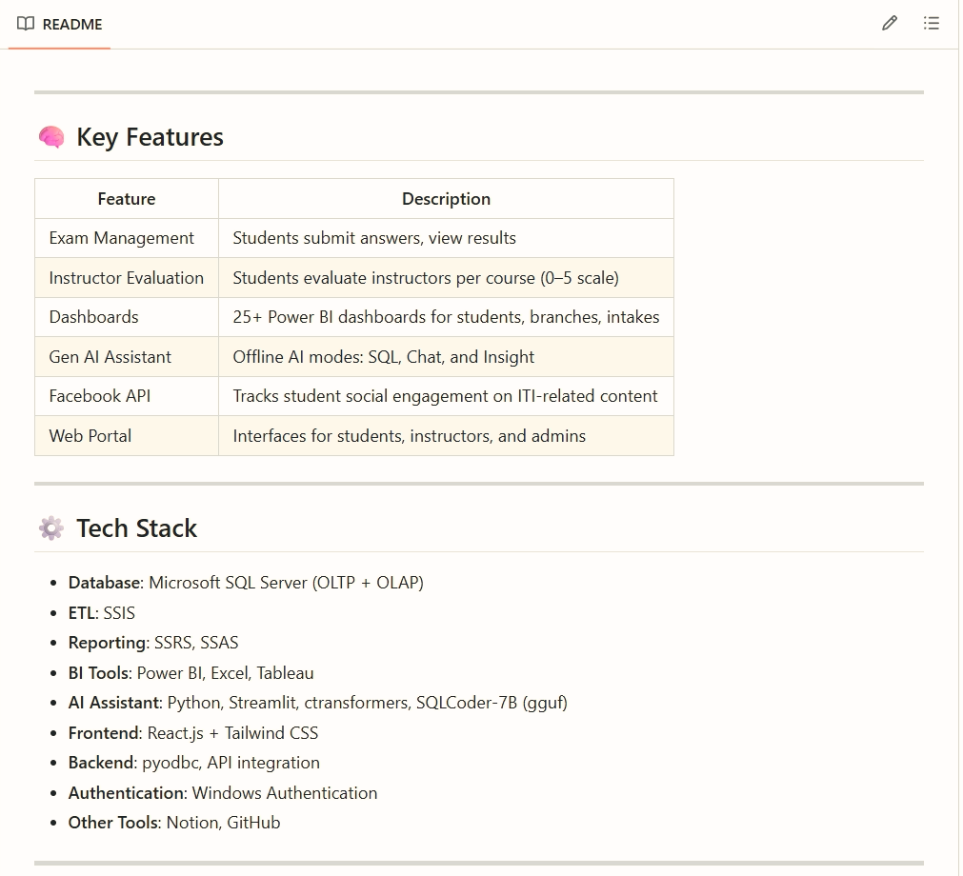
GitHub

Slide 10
DATABASES

Slide 11
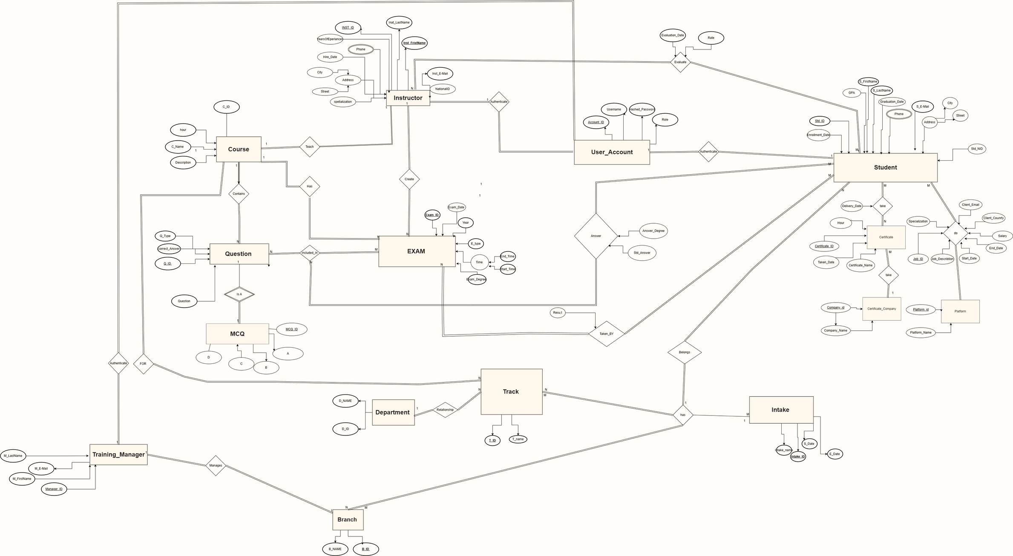
ERD

Slide 12
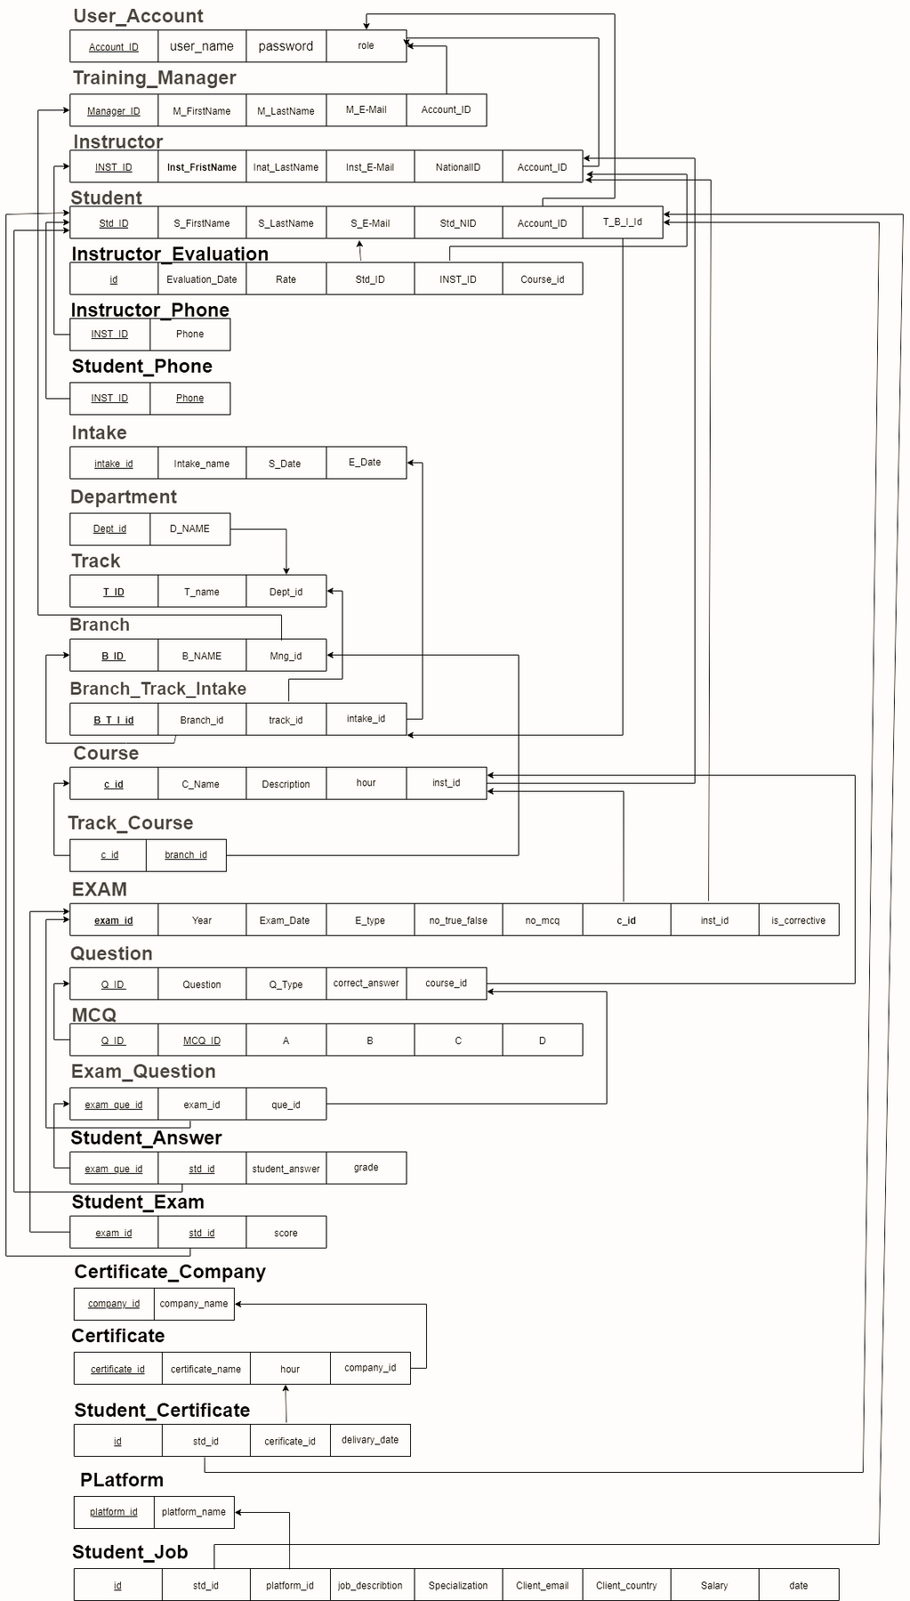
Schema

Slide 13

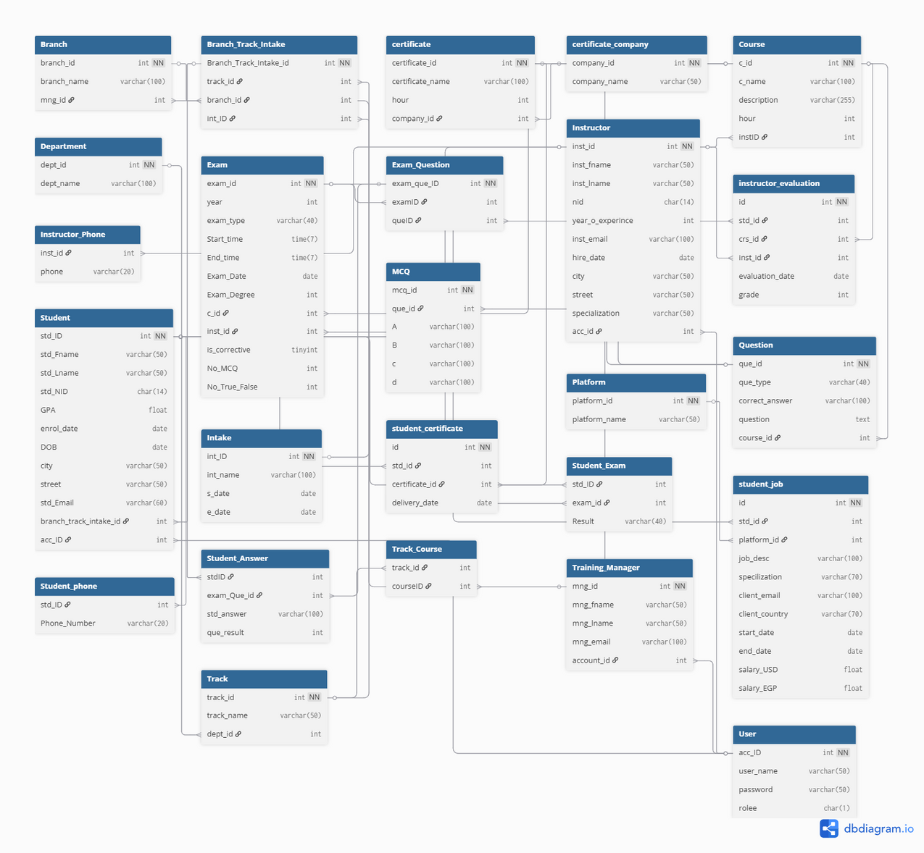
Mapping

Slide 14
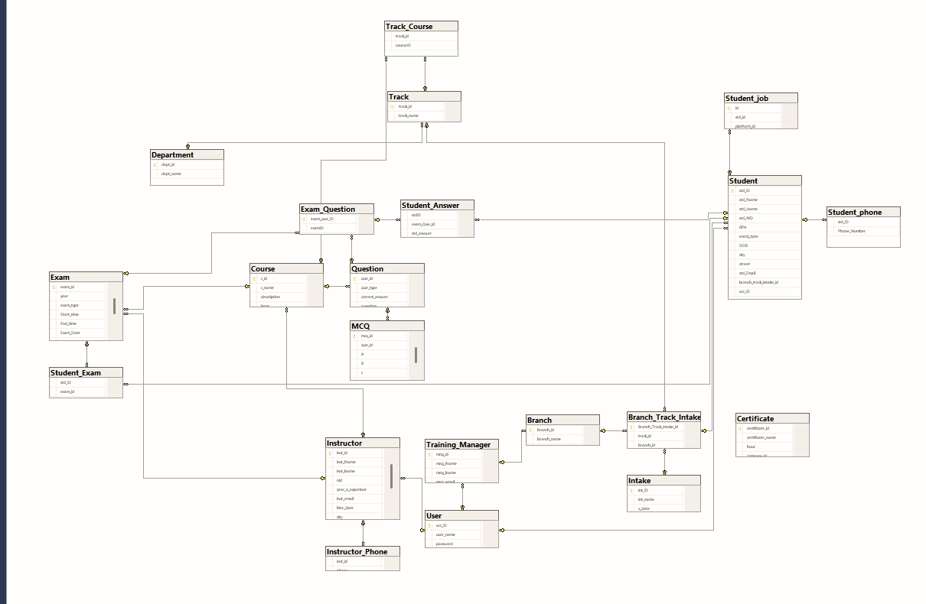
OLTP

Slide 15
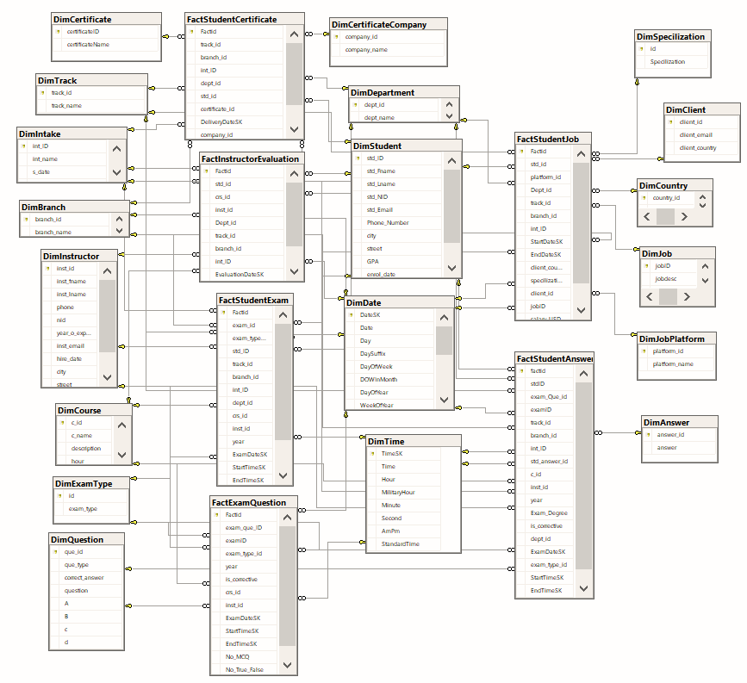
OLAP

Slide 16
ETL TOOLS

Slide 17
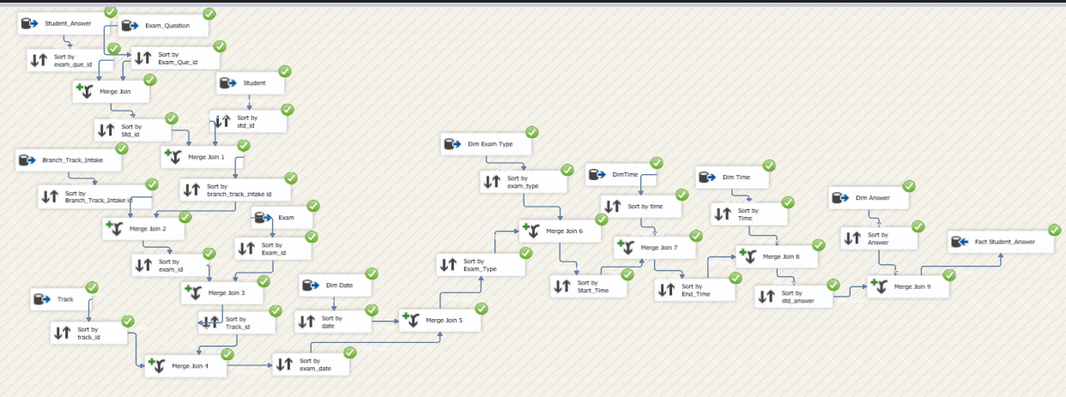
SSIS

Slide 18
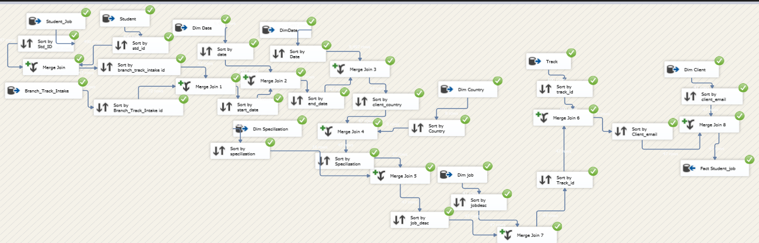
SSIS

Slide 19
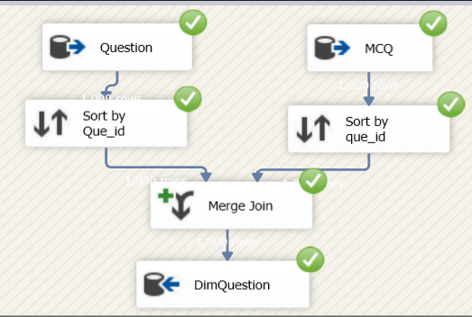
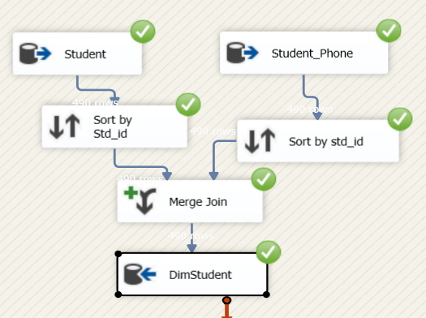
SSIS

Slide 20
SSRS
SSRS (SQL Server Reporting Services) is important for generating detailed, paginated reports from the OLTP and OLAP databases.
It allows ITI admins and managers to access printable, on-demand reports such as student scores, instructor evaluations, and exam summaries.
SSRS complements Power BI by offering formal, static reporting alongside interactive dashboards.

Slide 21
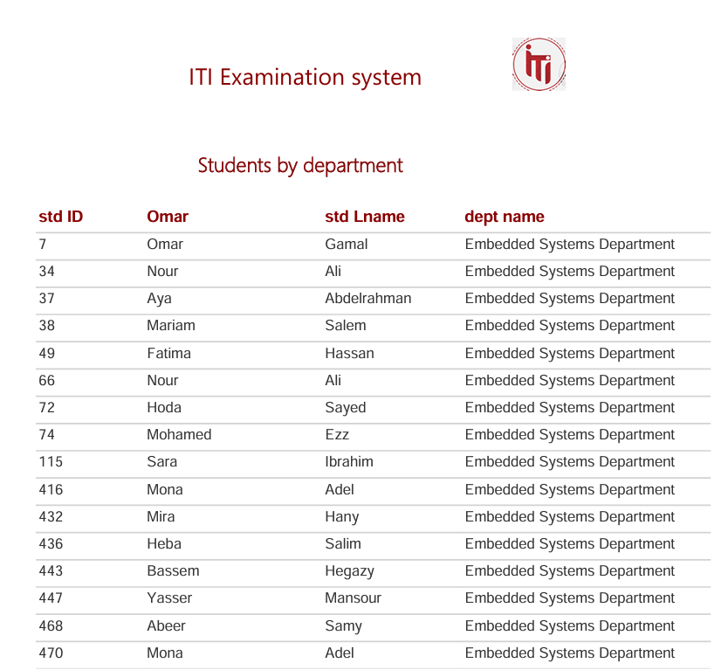
SSRS

Slide 22
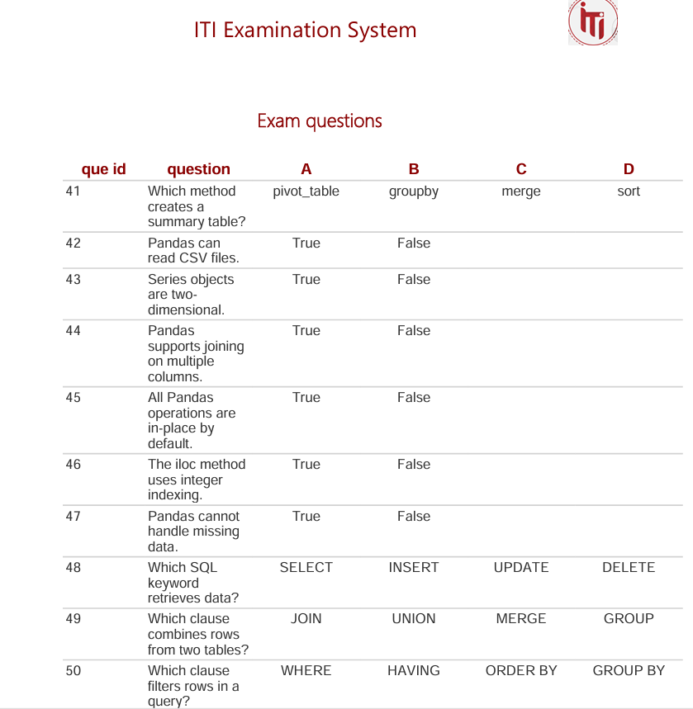
SSRS

Slide 23
Dashboards

Slide 24
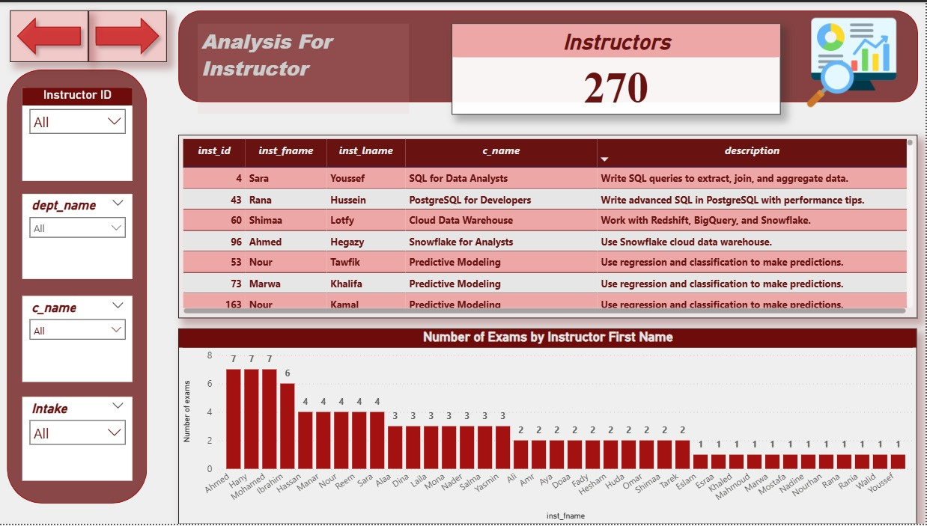
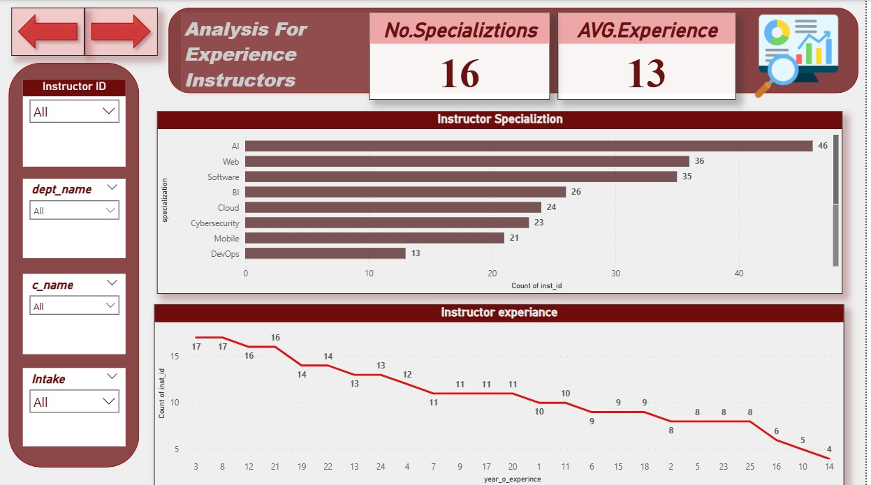
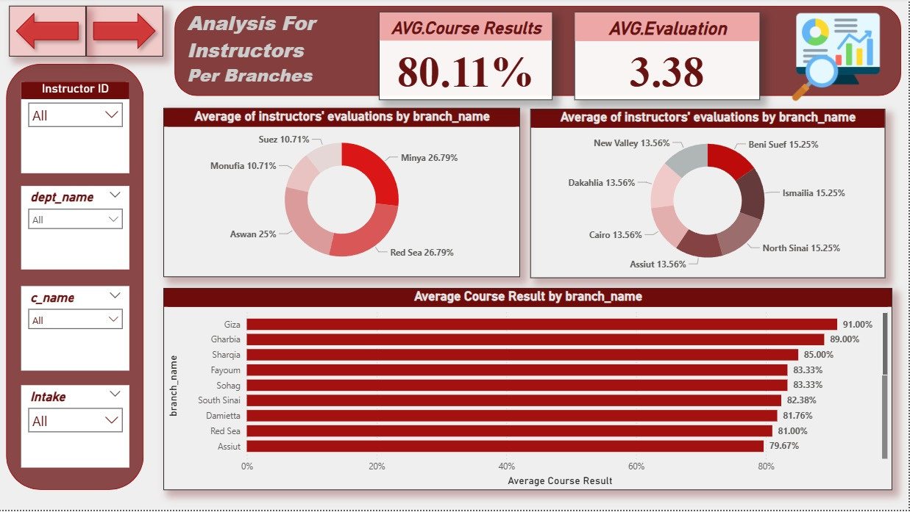
Power BI
Instructor Dashboard

Slide 25
Power BI
Instructor Dashboard

Slide 26
Power BI
Instructor Dashboard

Slide 27
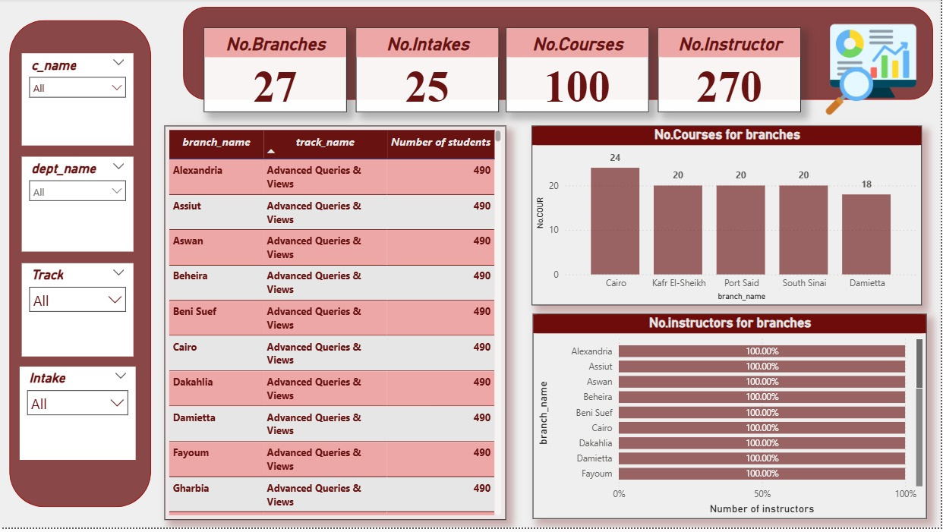
Power BI
Branch Dashboard

Slide 28
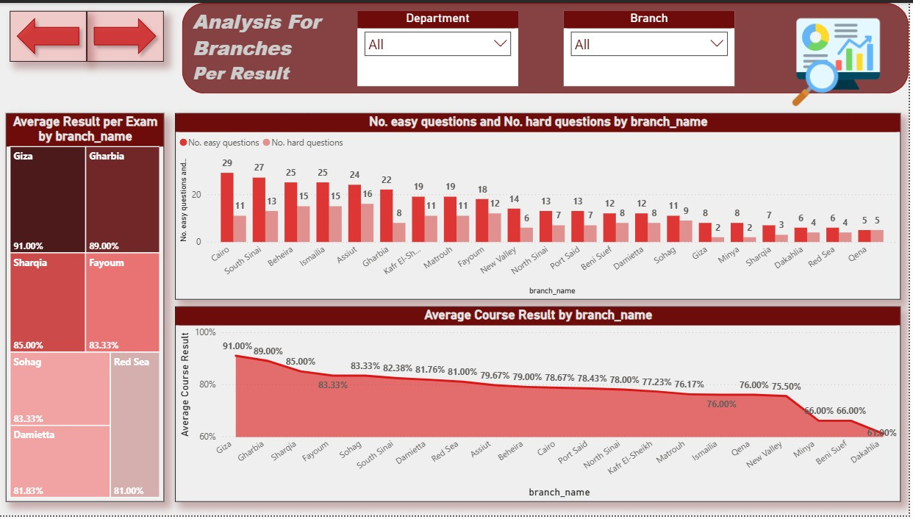
Power BI
Branch Dashboard

Slide 29
Power BI
Branch Dashboard

Slide 30
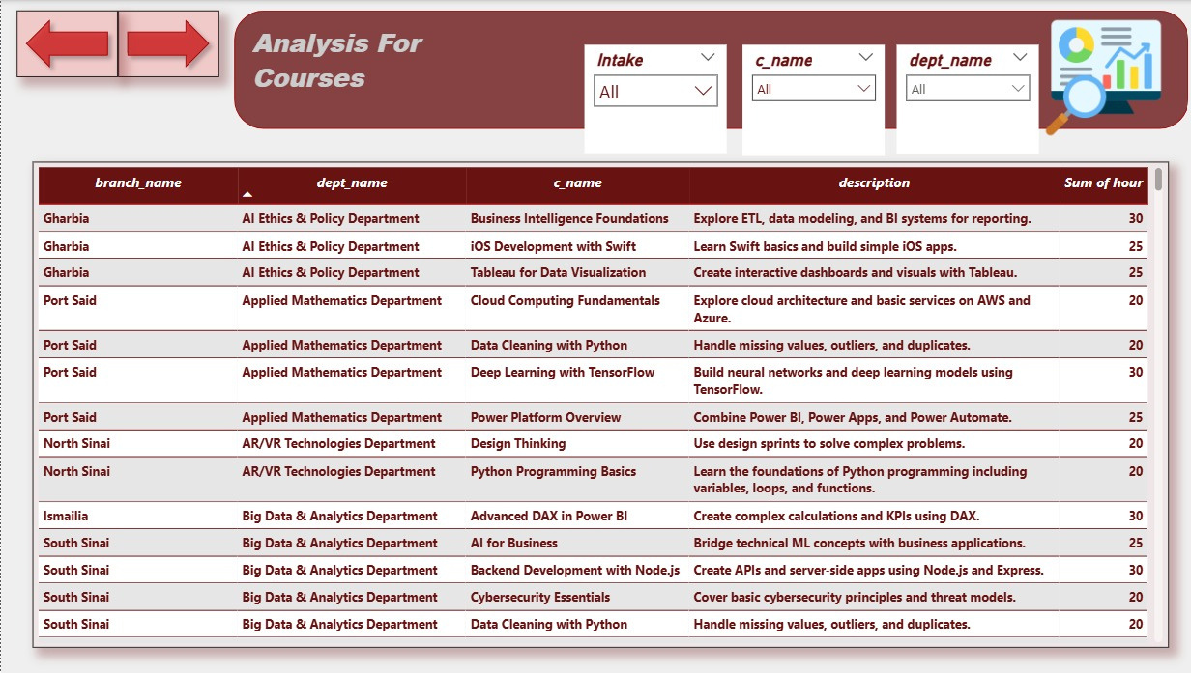
Power BI
Branch Dashboard

Slide 31
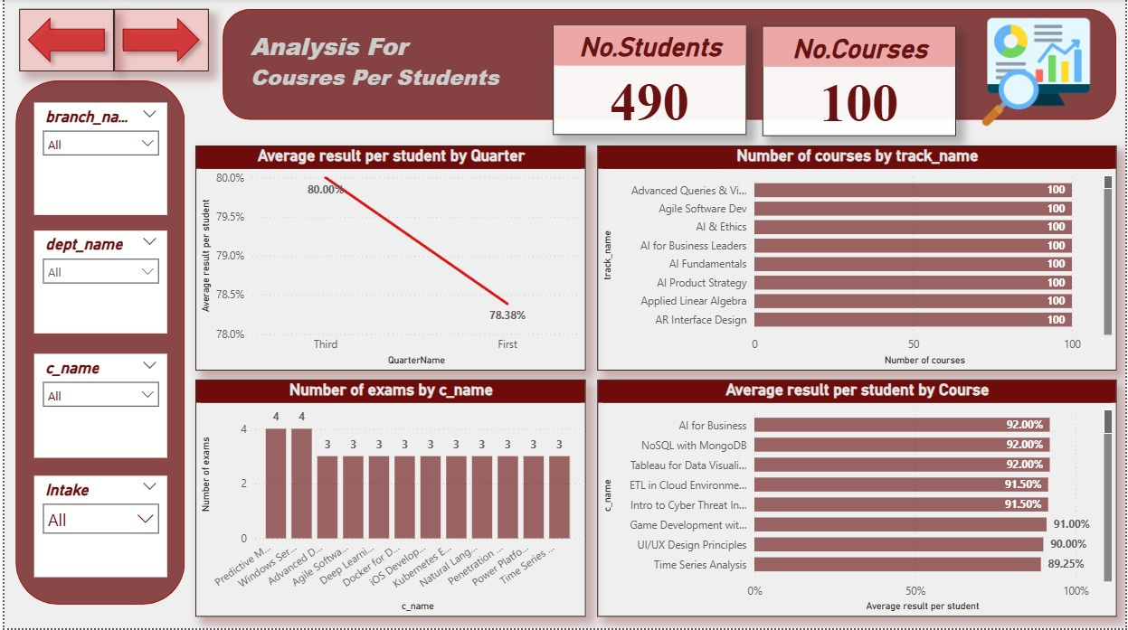
Power BI
Branch Dashboard

Slide 32
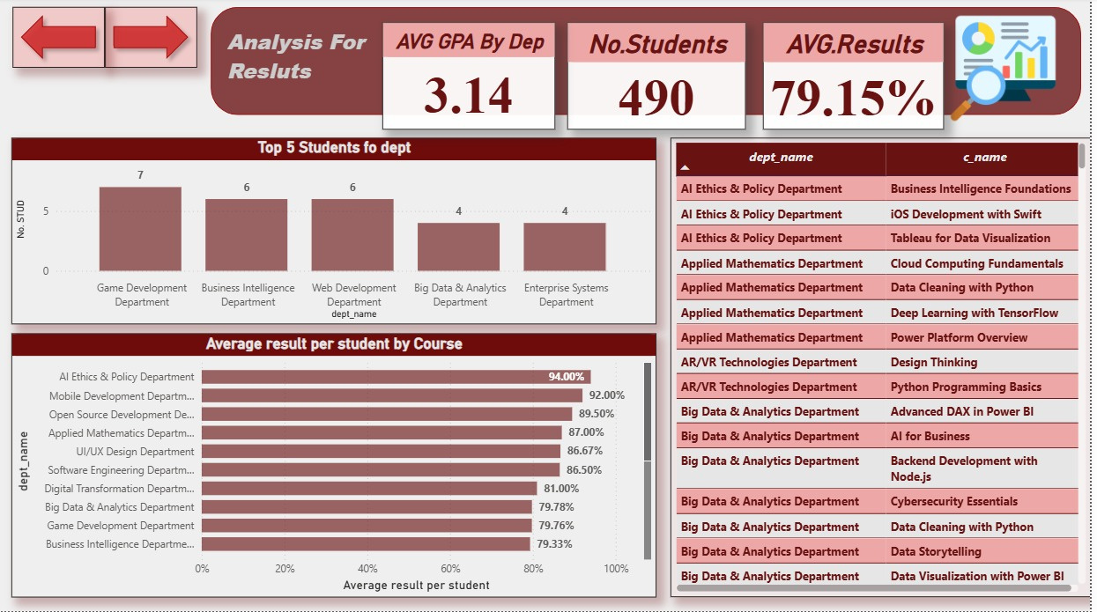
Power BI
Branch Dashboard

Slide 33
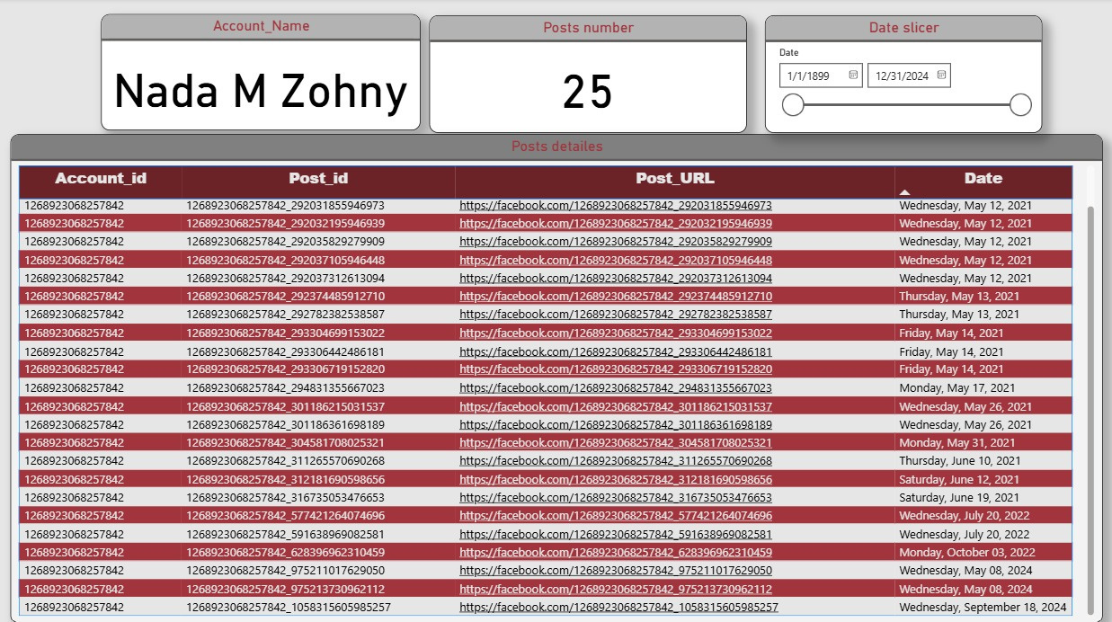
Power BI
API Facebook

Slide 34
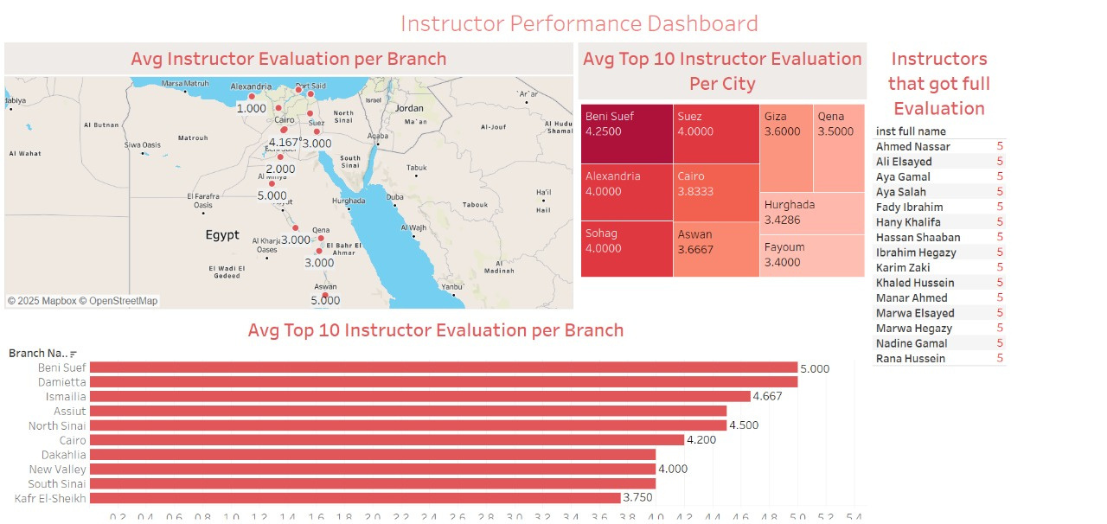
Tableau

Slide 35
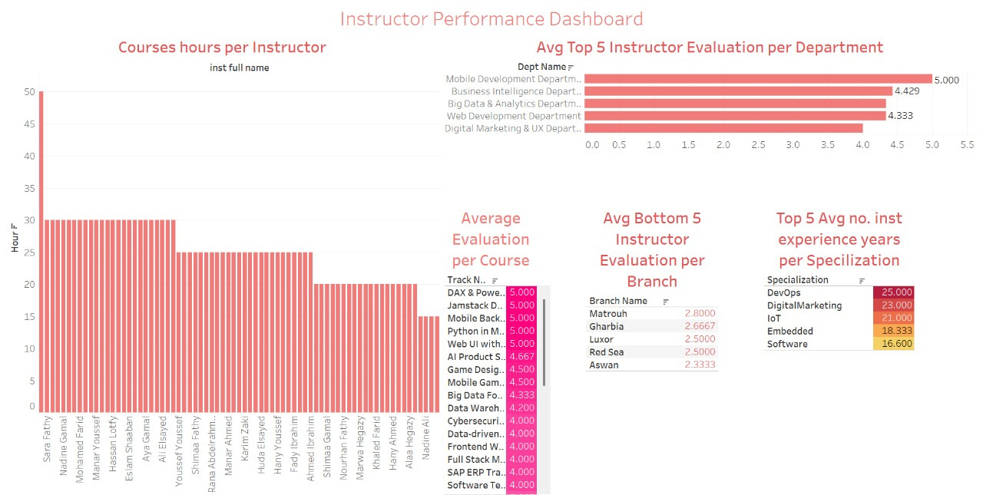
Tableau

Slide 36
Tableau

Slide 37
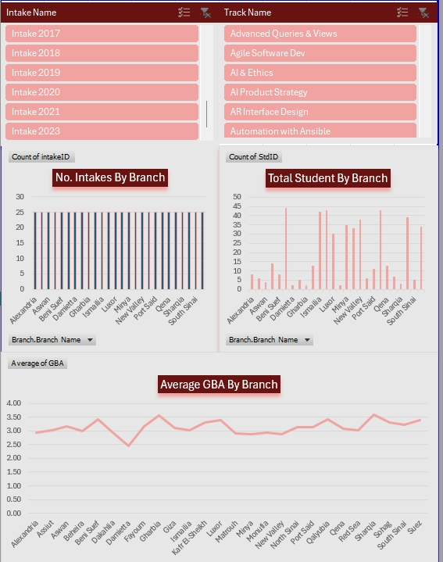
Excel

Slide 38
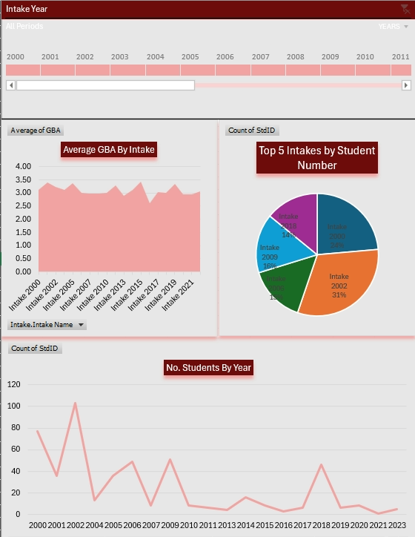
Excel

Slide 39
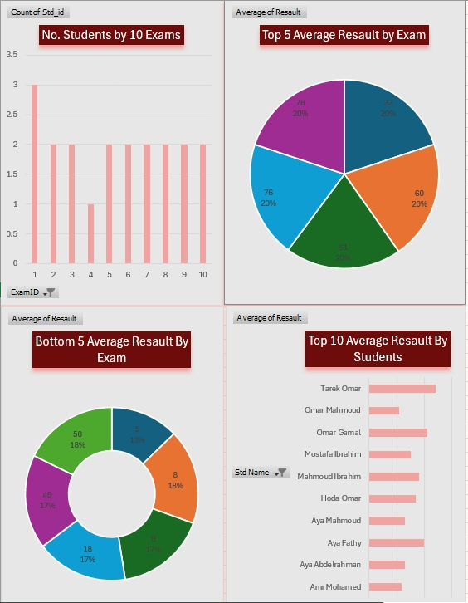
Excel

Slide 40
Generative AI

Slide 41
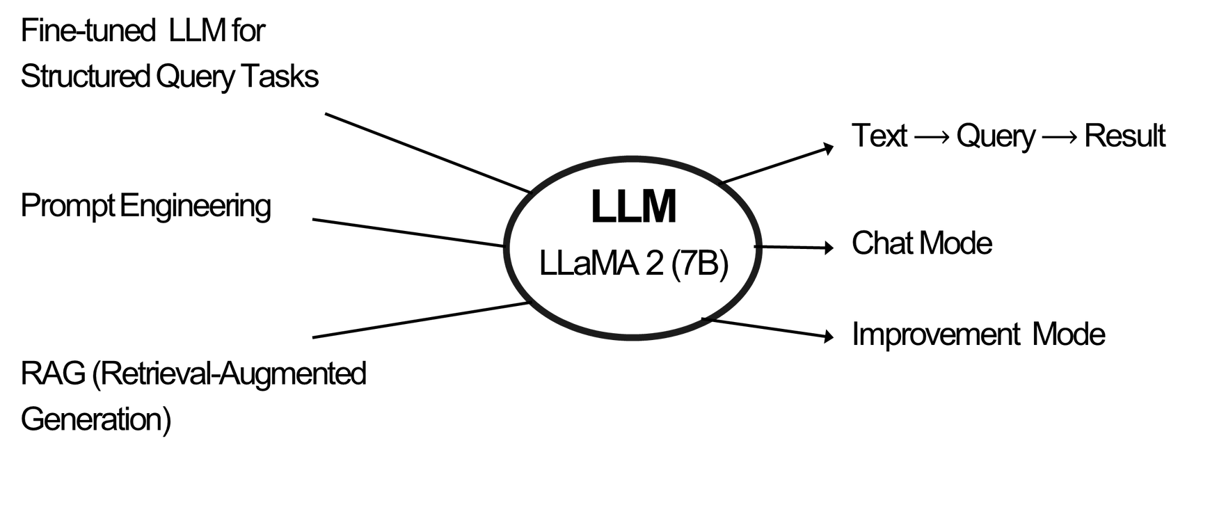
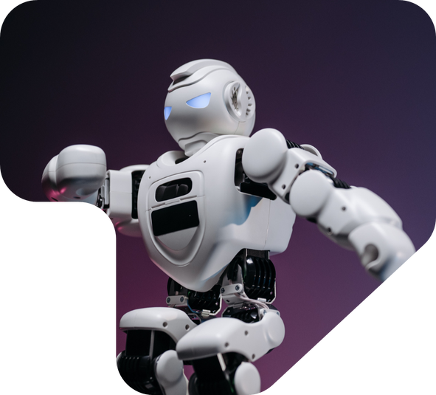
Generative AI

Slide 42
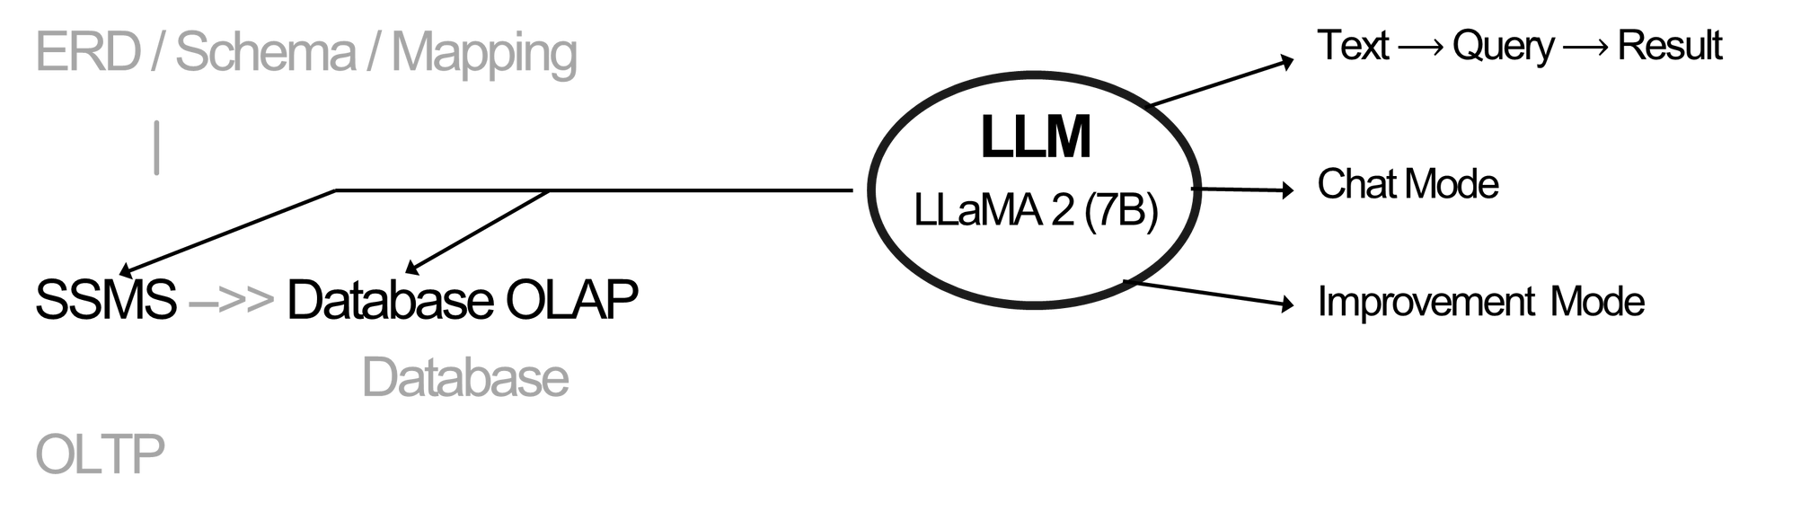
Generative AI

Slide 43
Website Interface

Slide 44
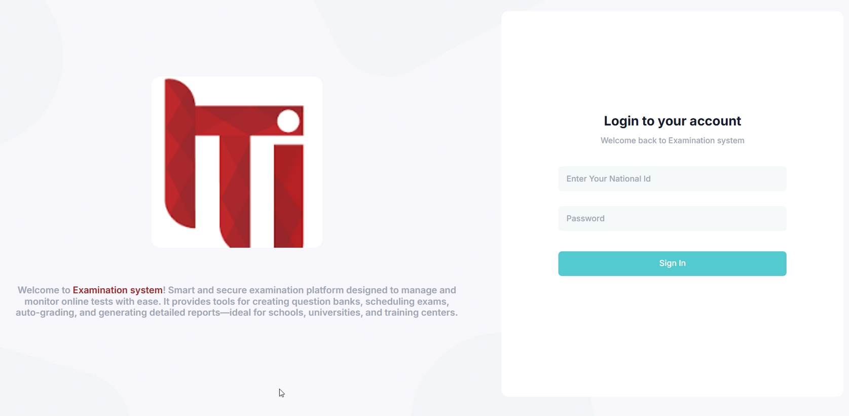
Website

Slide 45
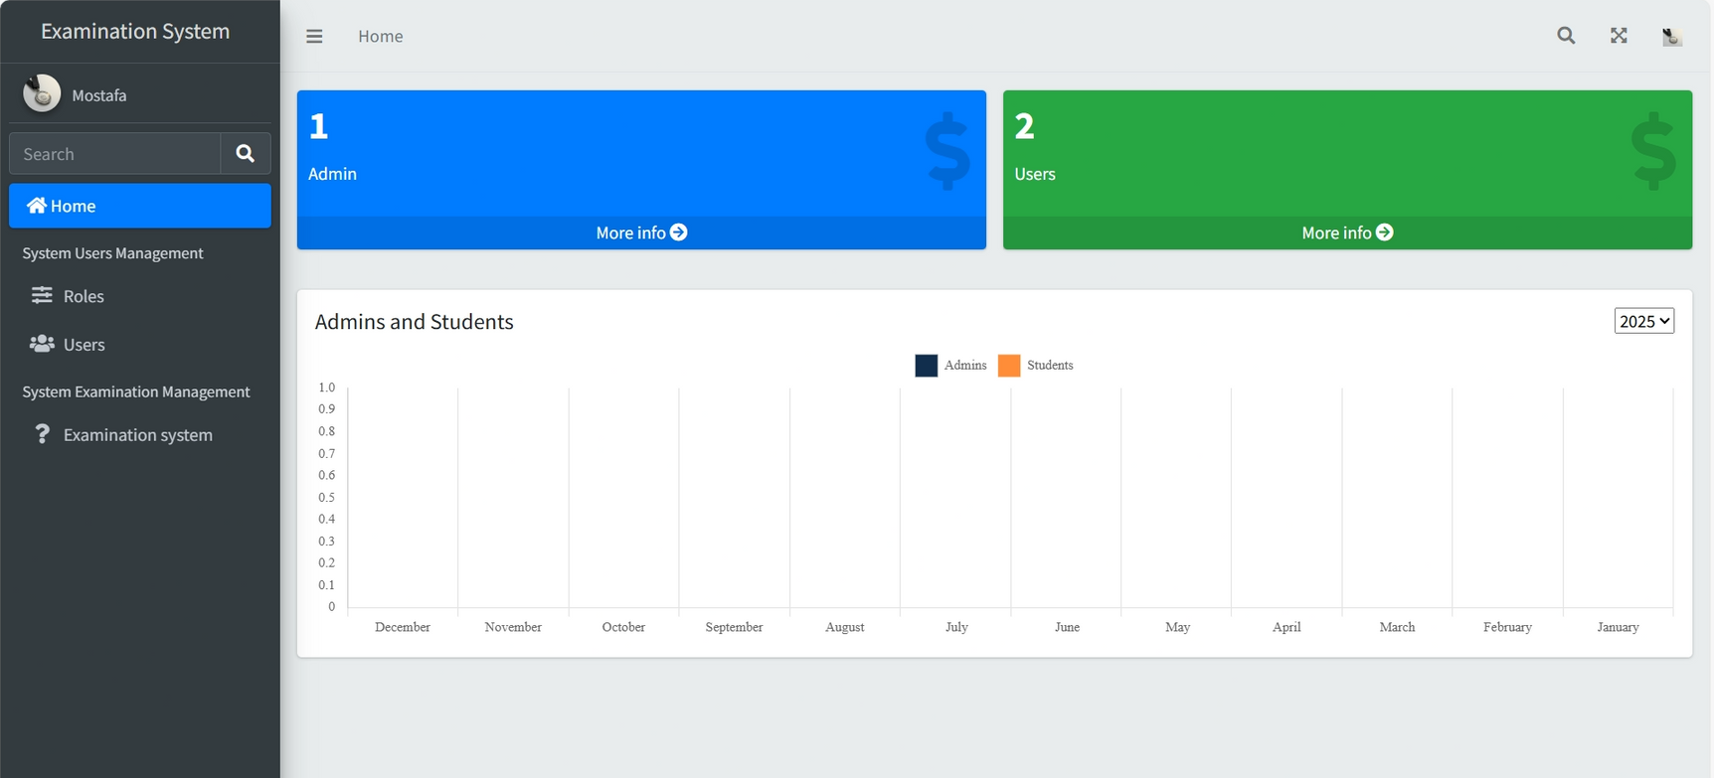
Website

Slide 46
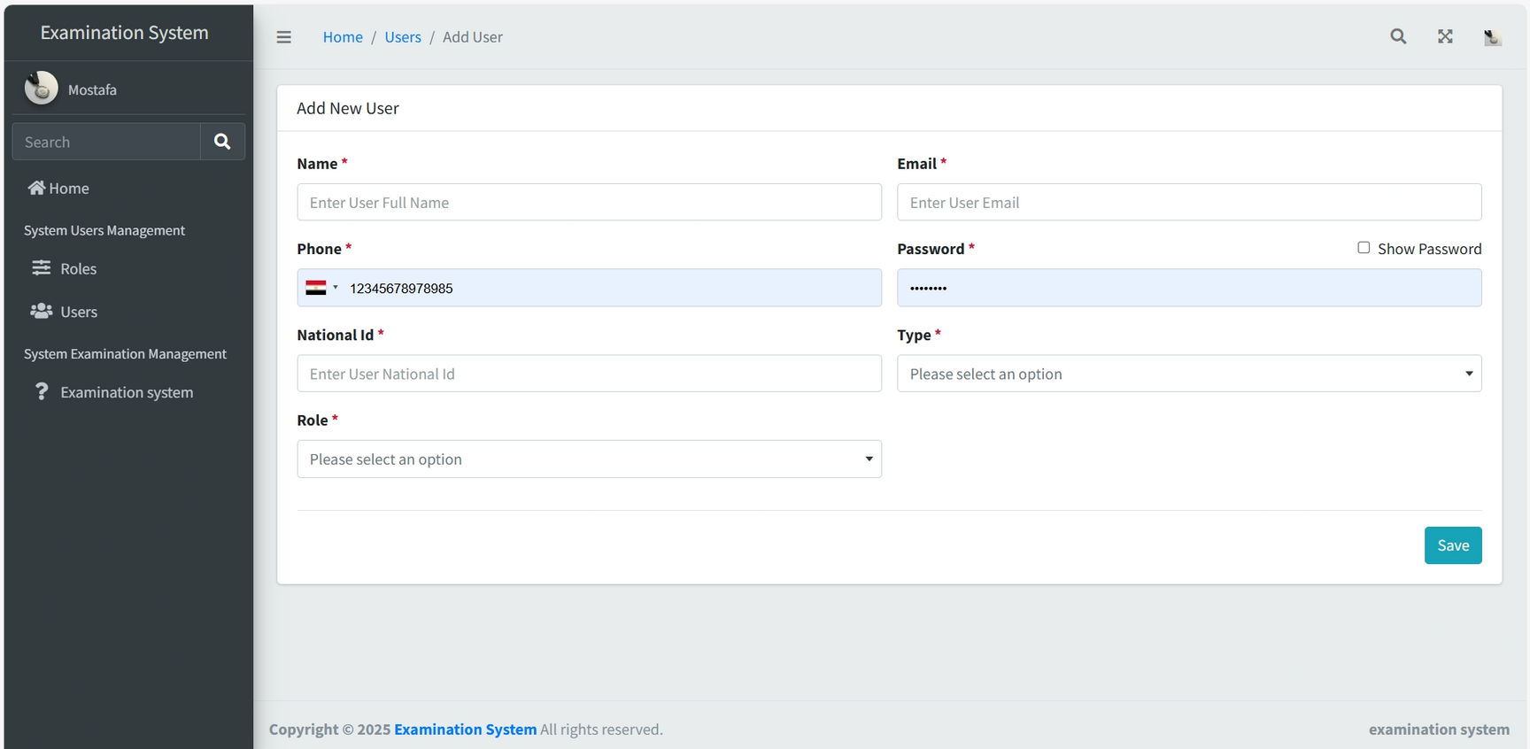
Website

Slide 47
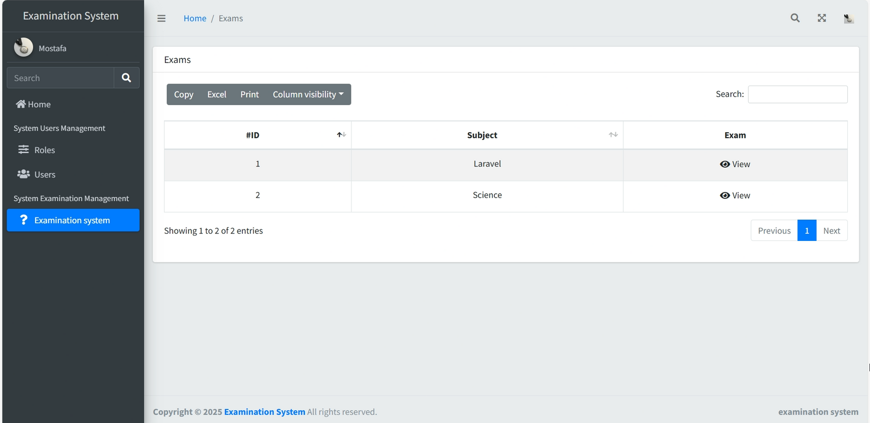
Website

Slide 48
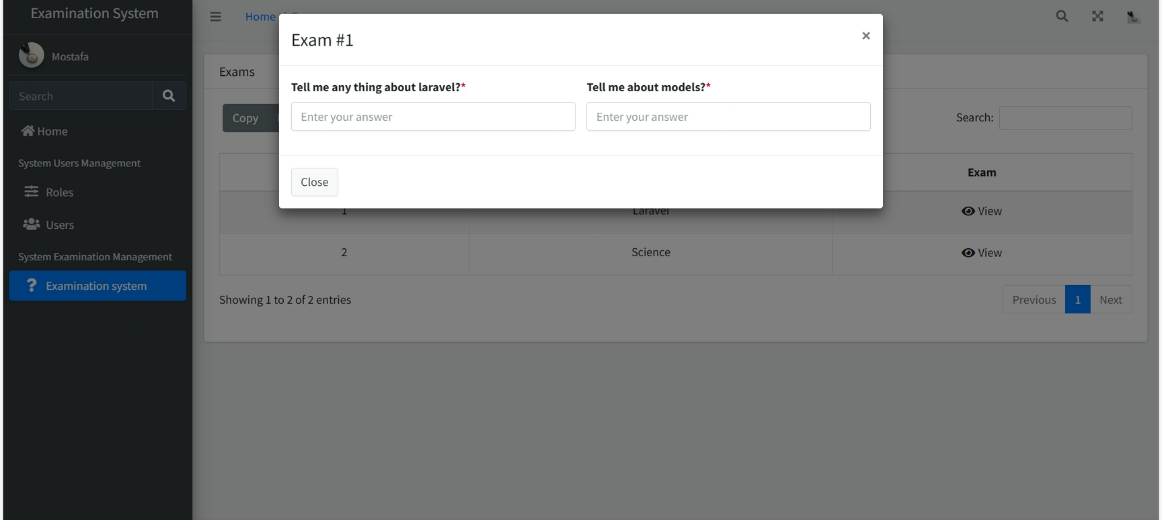
Website

Slide 49
Q&A Session

Slide 50
Thank You

